Slide 1

Introductory Computer Networking and IT Security
Week 1

Slide 2
Agenda
Introduction to network fundamentals
Communication model
Internetworking models
Networking elements and devices
Introduction to different network topology
Usages and future of computer networks

Slide 3
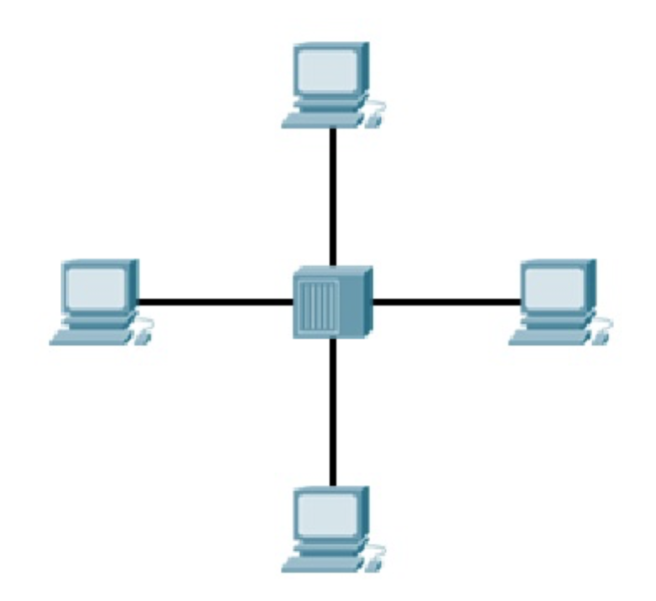
Computer network fundamentals and concepts
A computer network or data network is a telecommunications network which allows computers to exchange data.
a system of interconnected devices that can communicate using some common standards (called protocols). These devices communicate to exchange resources (e.g. files and printers) and services.

Slide 4
Computer Networks divided mainly into 3 categories
  Local Area Networks (LAN)
  Metropolitan Area Networks (MAN)
  Wide Area Networks (WAN)

Slide 5
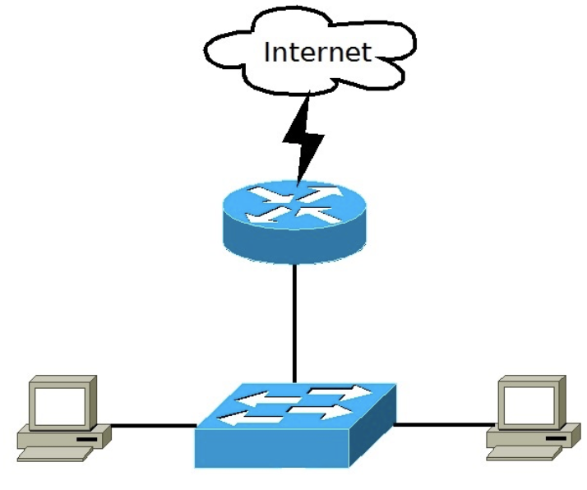
Local Area Networks (LAN)
a communications network that interconnects devices in a limited area (a house, office, building…). This type of network is usually capable of achieving high data transfer rate at low cost.
It is usually the case that the LAN is owned by the same organization that owns the attached devices.
Some of the most popular LAN technologies are Ethernet, Token Ring and FDDI. Most LAN networks use TCP/IP to communicate. Twisted-pair cabling is usually used in a LAN.

Slide 6
Local Area Networks (LAN)
Examples of local area network (LAN)
  Networking in home, office. SOHO (small office/home office) LAN consist of PCs, printers, switches, routers, and cabling that connects all these devices together.
  Wi-Fi (When we consider wireless LAN) & switched LAN.

Slide 7
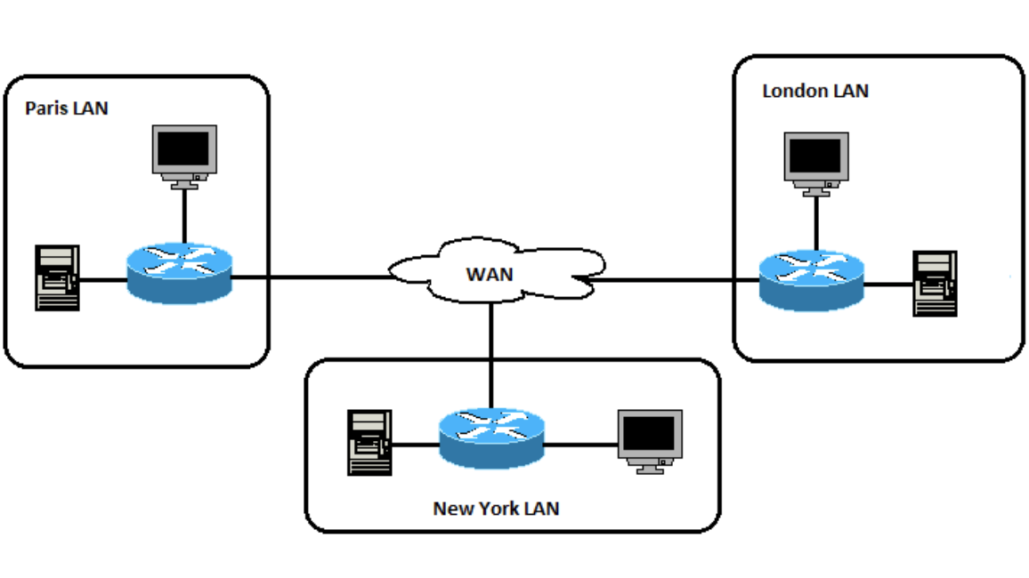
Wide Area Networks (WAN)
Covers a large geographical area.
Implemented using circuit switching and packet switching.
Significant fraction of the network assets is not owned rather lease.
Commonly used technologies are: Frame Relay, ATM, X.25

Slide 8
Wide Area Networks (WAN)
Example of Wide area network (WAN)
Internet is the example of WAN.

Slide 9
Metropolitan Area Networks (MAN)
MAN is a communications network that interconnects area of few city blocks or entire city.
The scope of the MAN is larger than LANs and smaller than WANs.
Increasingly displaced by technologies like Metro Ethernet.
The most common technologies used are Asynchronous Transfer Mode (ATM), Fiber Distributed Data Interface (FDDI), Metro Ethernet.

Slide 10
Metropolitan Area Networks (MAN)
Examples of Metropolitan area network (MAN)
  Networking between banks in a city.
  Used in air reservation.
  TV cable

Slide 11
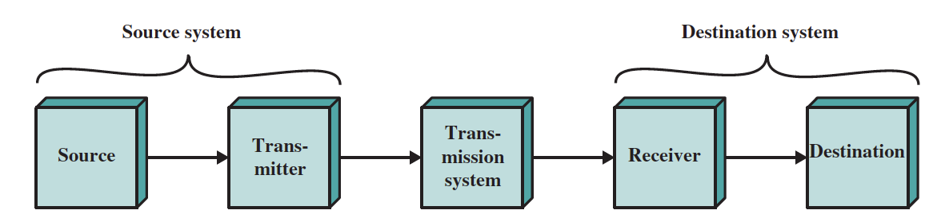
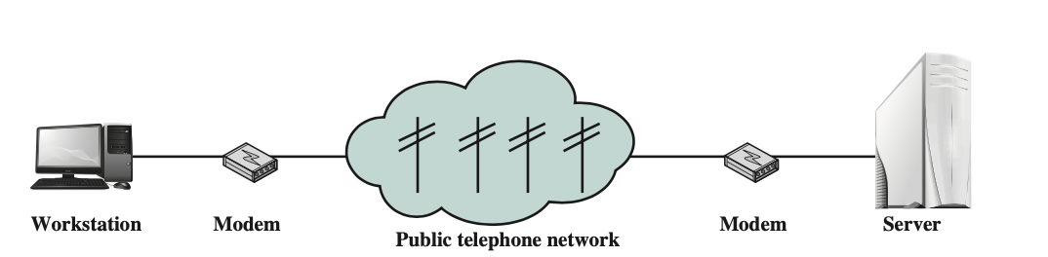
Communication Model

Slide 12
Communication Model
Source
  This device generates the data to be transmitted; examples are telephones and personal computers.
Transmitter
  Transmitter transforms and encodes the information in such a way as to produce electromagnetic signals that can be transmitted across some sort of transmission system.
Transmission System
  This can be a single transmission line or a complex network connecting source and destination.

Slide 13
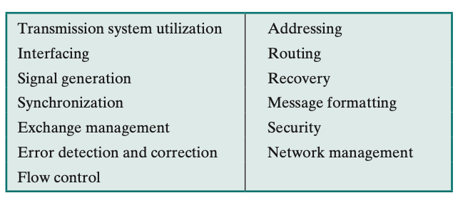
Communication Model
Receiver
  The receiver accepts the signal from the transmission system and converts it into a form that can be handled by the destination device.
Destination
  Takes the incoming data from the receiver.

Slide 14
Internetworking Models (OSI Model and TCP/IP Model)
OSI stands for Open Systems Interconnection. It has been developed by ISO – ‘International Organization of Standardization‘, in the year 1974.
TCP/IP model, it was designed and developed by Department of Defense (DoD) in 1960s and is based on standard protocols. It stands for Transmission Control Protocol/Internet Protocol.

Slide 15
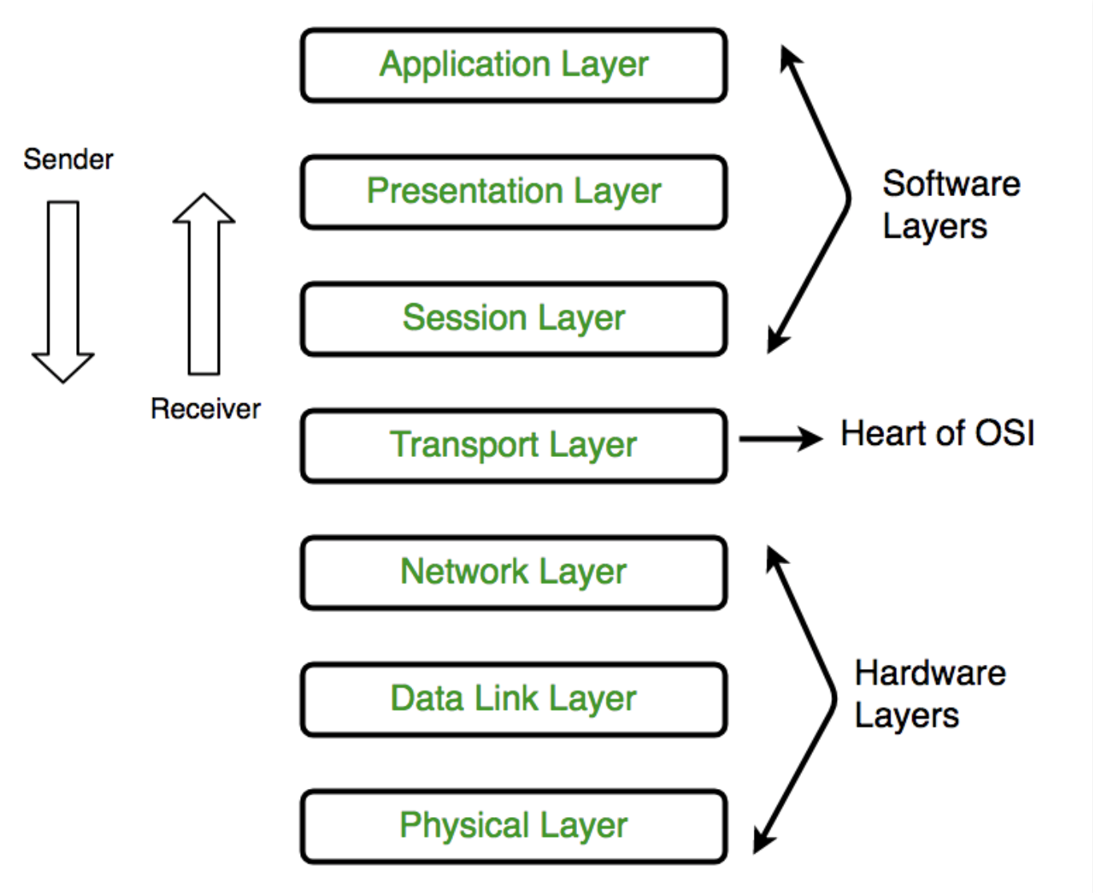
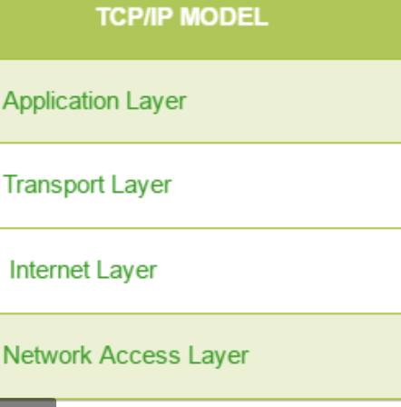

Slide 16
Common Networking Elements and Devices
  Repeater or Hubs
  Bridges
  Switches
  Routers
  Gateways
  Firewalls
  Wireless Access Points
  Network Interfaces

Slide 17
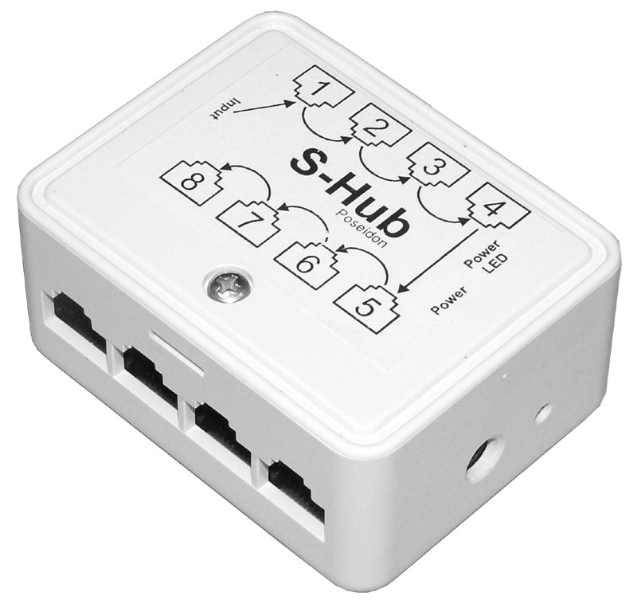
Repeater or Hubs
  A repeater is an electronic device that receives a network signal, cleans it of unnecessary noise and regenerates it. A hub is a multiport repeater.
  No filtering and no addressing
  Works on physical layer

Slide 18
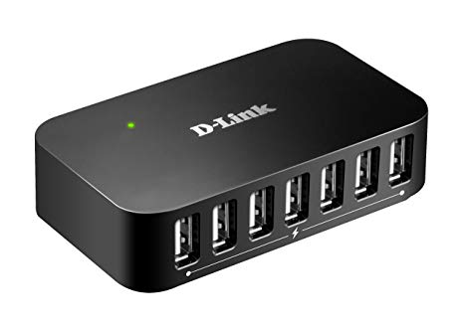
Repeater or Hubs
Types:
1.Passive Hub
-no power supply needed
-transmit signal as it is
2.Active Hub(Multiport Repeater)
-power supply is needed
-regenerate signal and transmit it

Slide 19
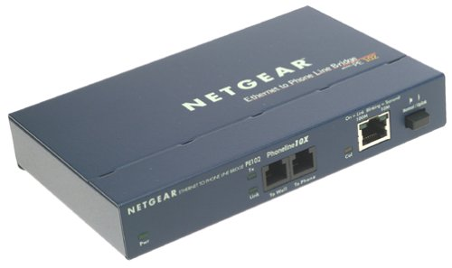
Bridges
  A network bridge connects and filters traffic between two network segments
  Works on data link layer
  only transmit signal if destination address is available to outgoing port
  data filtering

Slide 20
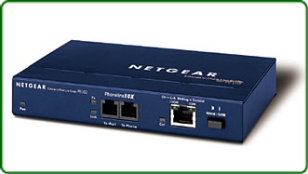
Bridges
  maintains signal traffic and elongate network
  differentiate collision domain
  do not handle broadcasting
  slower than switch as it uses s/w for switching
  one incoming and one outgoing port

Slide 21
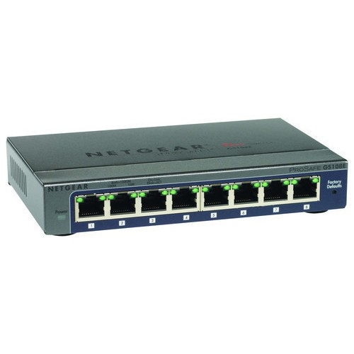
Switches
  A network switch is a device that forwards and filters datagrams (frames) between ports based on the destination MAC address in each frame. Switches are based on Application Specific Integrated Circuit (ASIC)
  Filtering is done
  Maintains MAC table
  Works on data link layer

Slide 22
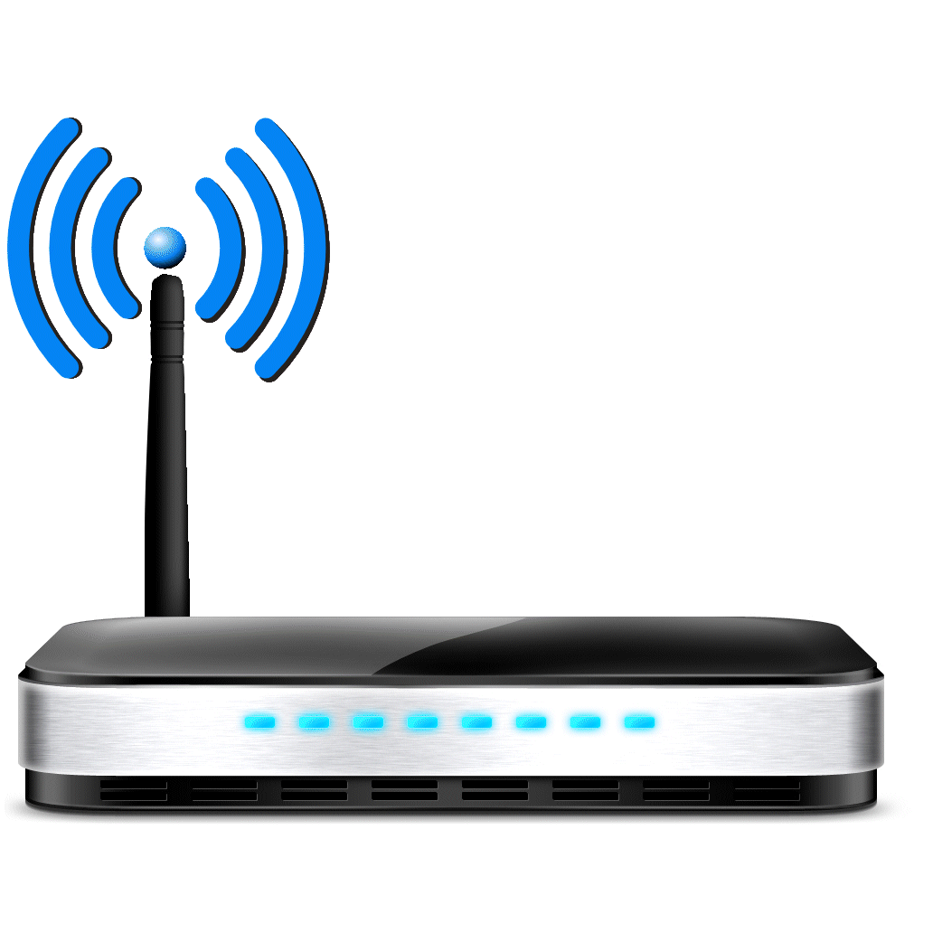
Routers
  A router is an internetworking device that forwards packets between networks by processing the routing information included in the packet or datagram
  It works on different protocols
  Controls collision domain and broadcast domains
  Works on network layer
  Maintains routing table for routing

Slide 23
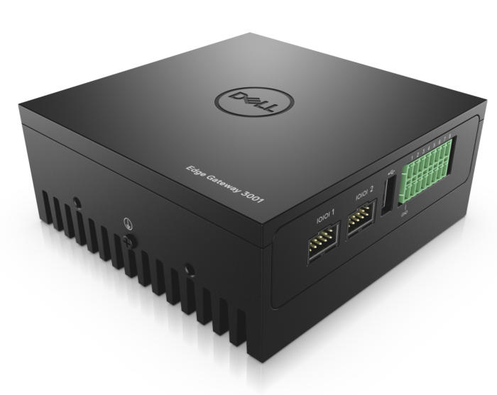
Gateway
  Connect different networks.
  Combination of hardware and software so that it can works on different architecture and protocols.
  It works on network and all layers above network layer.
  Mostly works on Application layer.

Slide 24
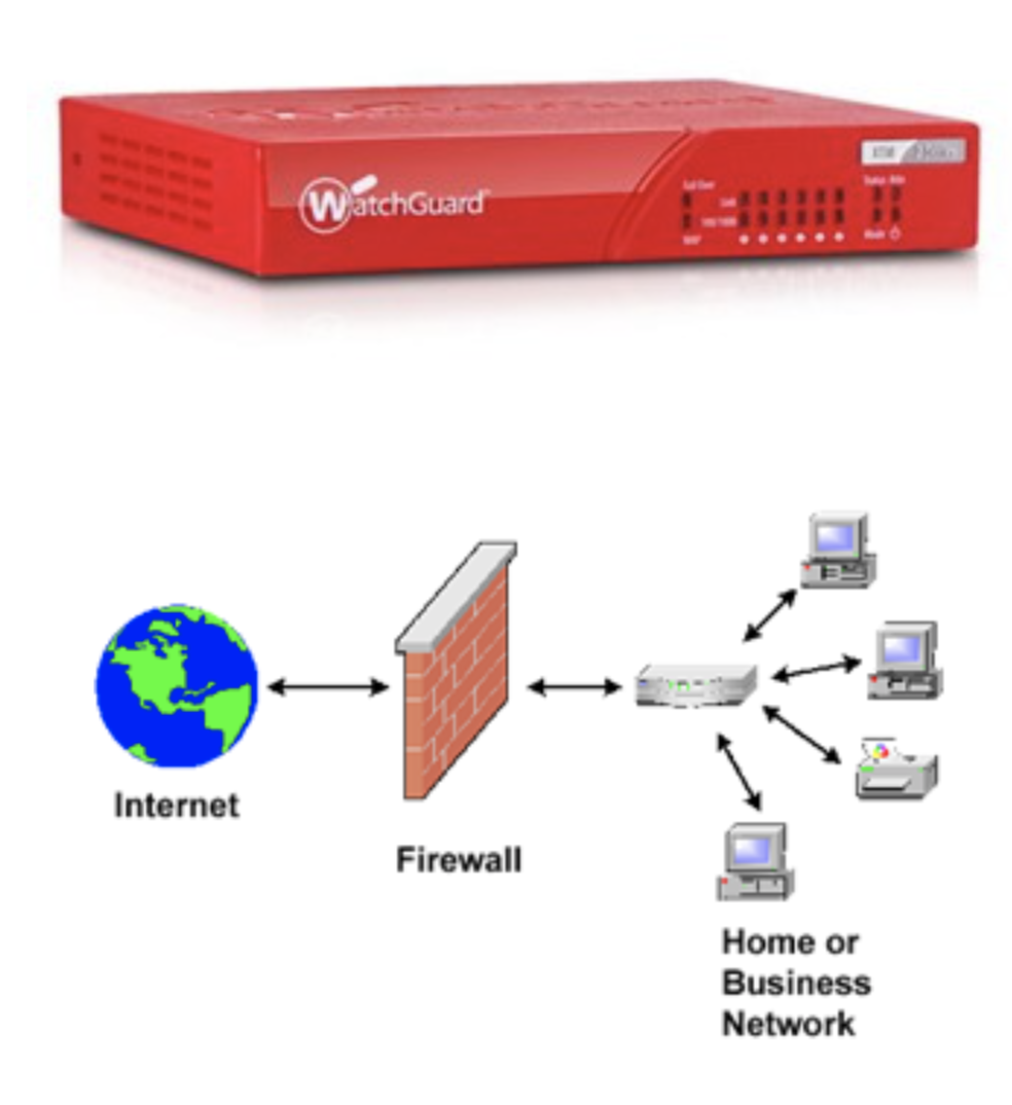
Firewalls
System designed to prevent unauthorized access to/from private network
Can be hardware or software
Used to prevent unauthorized users from accessing private networks

Slide 25
Firewalls
Techniques – packet filtering, application gateway, circuit-level gateway, proxy server
Prevents harm from getting in or out of the network.

Slide 26
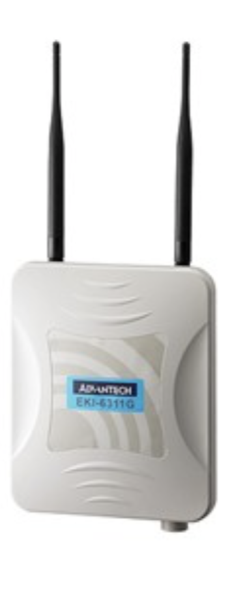
Wireless Access Points
Acts as a communication hubs for users of wireless devices to wired networks
Can be hardware or software
Extends physical range of service a wireless user has access to

Slide 27
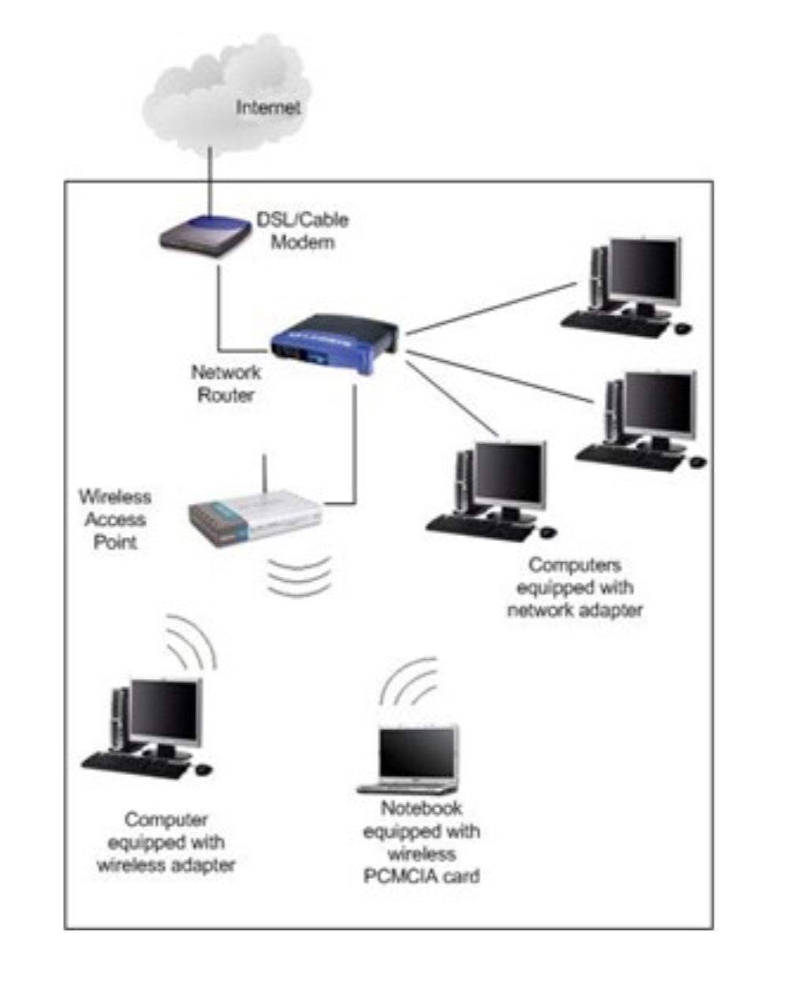
Wireless Access Points
Provides heightened security
Used almost everywhere including places like business, home, schools

Slide 28
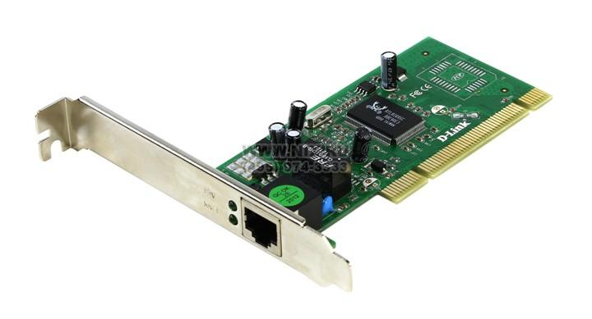
Network Interfaces
  A network interface controller (NIC) is computer hardware that provides a computer with the ability to access the transmission media, and has the ability to process low-level network information.

Slide 29
Network Topology
A topology is a map of a network.
The physical topology of a network describes the layout of the cables and workstations and the location of all network components
defines how the information or data flows within the network.
There are four most common topologies:
Bus
Star
Ring
Mesh

Slide 30
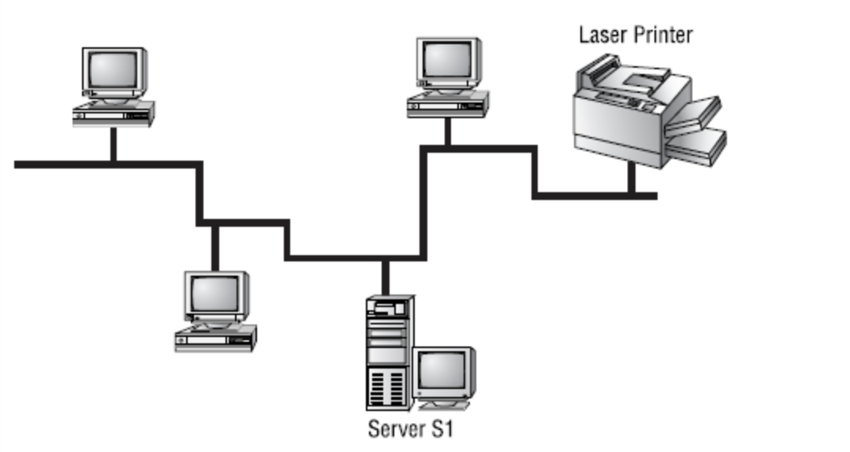
Bus Topology
All computers are attached to a single continuous cable that is terminated at both ends.
It is the simplest way to create a physical network. Originally, computers were attached to the cable with wire taps.

Slide 31
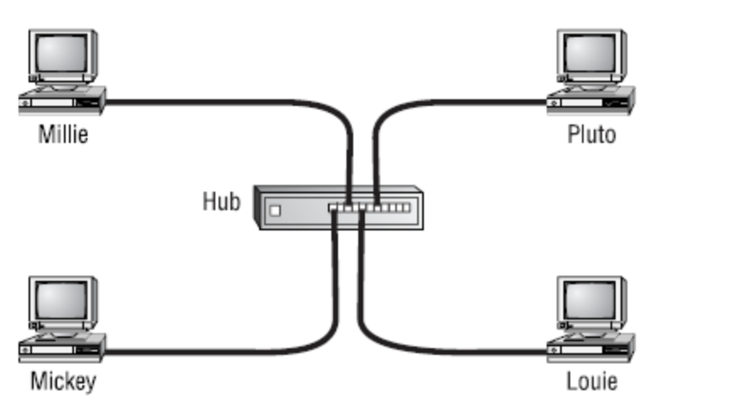
Star Topology
computers in a star topology is connected to a central point by a separate cable or wireless connection.
The central point is a device known by such names as hub, switch, and AP
Star topology is much more fault tolerant than a bus topology.

Slide 32
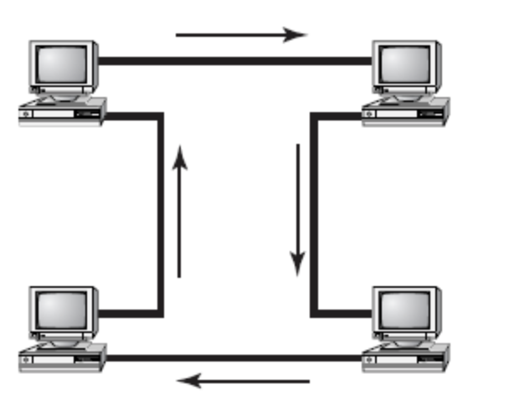
Ring Topology
Each computer is connected directly to two other computers in the network.
Data moves down a one-way path from one computer to another.
Any break, such as adding or removing a computer, disrupts the entire network. it is very difficult to reconfigure without bringing down the whole network.

Slide 33
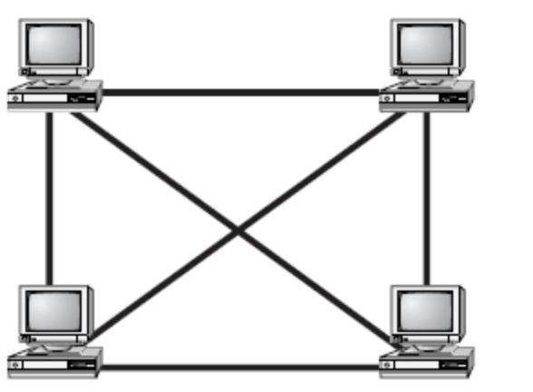
Mesh Topology
A path exists from each station to every other station in the network, resulting in the most physical connections per node of any topology.
hybrid mesh—is used on the Internet and other WANs in a limited fashion.
Hybrid mesh topology networks can have multiple connections between some locations, but this is done only for redundancy.

Slide 34
Selecting Topology
On the basis of:
Cost
Ease of installation
Ease of maintenance
Cable fault tolerance

Slide 35
Usages of computer networks
Computer Networks: Business Applications:
1. Resource Sharing:
All programs, equipment (printers), and especially data, available to anyone on the network without regard to the physical location of the resource and the user.
2. Server-Client model:
In this model, the data is stored on powerful computers called Servers. Often these are centrally housed and maintained by a system administrator. In contrast, the employees have simple machines, called Clients, on their desks, using which they access remote data.

Slide 36
Usages of computer networks
Computer Networks: Business Applications:
3. Communication Medium:
e-mail (electronic mail), video conferencing
4. eCommerce:

Slide 37
Usage of Computer networks
Computer Networks: Home Applications
Some of the most important uses of the Internet for home users are as follows:
Access to remote information
Person-to-person communication
Interactive entertainment
Electronic commerce
Computer Networks: Mobile Users

Slide 38
Usage of computer network
Other Uses of Computer Networks
  Data sharing
  Instantaneous sharing of information
  Collaborations
  Streamlined business processes
  Flexibility
  Resource sharing
  Now computer networks are used for all voice, video and data

Slide 39
Future of computer networks
SDN
5G and Supported Applications
Micro-service architecture
4D Network

Slide 40
Usages of computer networks
Software defined networks (SDN)
  A network organizing technique that has come to recent prominence is the software-defined network (SDN).
  An SDN separates the data and control functions of networking devices, such as routers, packet switches, and LAN switches.
  SDN provides future networking requirements for agility, automation, security, automations.
  The cloud computing and virtualization has changed the way we used computer networks.

Slide 41
Future of computer networks
5G
  5G or 802.11ac, is the next step in wireless technology.
  5G will provide that by annexing radio spectrum that are 1 millisecond. (Superfast movie download)
  5G would be made possible by SDN and support a variety of devices and applications.
  This will allow further development in such arenas as driverless cars, virtual reality , or computer simulated, 3D images, wearables and possibly no-touch computing

Slide 42
Future of computer networks
Micro-service architecture
  It refers to small independent modules within software applications.
  With micro-service architecture, each module will run independently of the other on the network, so you can adjust each one as needed.
  With this, and increased speed, you could transmit data from Java to another application and take the advantage of several applications.

Slide 43
Future of computer networks
4D Network
  It is an attempt to eliminate the need for Internet Protocol that we know today.
  Internet Protocol is an old system and has some vulnerability and inefficiency as.
  A 4D Network would restructure how packets of information are handled by following the 4 network planes:
    Decision plane - creating a network configuration
    Dissemination plane - getting information and sending out decision plane output to routers
    Discovery plane - letting devices 'discover' their directly connected neighbors;
    Data plane - directing the forwarding of network traffic.

Slide 44


Slide 45
Summary
Networking concepts (LAN, MAN, WAN)
Communication model ( sender, transmitter, transmission system, receiver, destination)
Introduction to internetworking models ( OSI & TCP/IP Models)
Different networking devices (router, switches, hubs, access points)
Network topology ( star, ring, bus, mesh)
Usage and future of computer network)

Slide 46
THANK YOU

